Slide 1
Verilog HDL语言
主讲：李榕
Email: lr@hust.edu.cn
QQ: 179825425
华中科技大学计算机科学与技术学院

Slide 2
Verilog程序设计方法

Slide 3
Module Styles
Modules can be specified different ways
  Structural（结构描述） – connect primitives and modules
  Dataflow（数据流描述）– use continuous assignments
  Behavioral（行为描述） – use initial and always blocks
A single module can use more than one method!
What are the differences?

Slide 4
Structural Example
module majority (major, V1, V2, V3) ;
output major ;
input V1, V2, V3 ;
wire N1, N2, N3;
and A0 (N1, V1, V2),
A1 (N2, V2, V3),
A2 (N3, V3, V1);
or Or0 (major, N1, N2, N3);
endmodule
V1
N1
A0
V2
V2
A1
N2
Or0
major
V3
V3
A2
N3
V1
majority

Slide 5
Dataflow Example
module majority (major, V1, V2, V3) ;
output major ;
input V1, V2, V3 ;
assign major = V1 & V2
| V2 & V3
| V1 & V3;
endmodule
majority
V1
V2
major
V3

Slide 6
Behavioral Example
module majority (major, V1, V2, V3) ;
output reg major ;
input V1, V2, V3 ;
always @(V1, V2, V3) begin
if (V1 && V2 || V2 && V3
|| V1 && V3) major = 1;
else major = 0;
end
endmodule
majority
V1
V2
major
V3

Slide 7
Full Adder: Structural
module half_add (X, Y, S, C);
input X, Y ;
output S, C ;
xor SUM (S, X, Y);
and CARRY (C, X, Y);
endmodule
module full_add (A, B, CI, S, CO) ;
input A, B, CI ;
output S, CO ;
wire S1, C1, C2;
// build full adder from 2 half-adders
half_add PARTSUM (A, B, S1, C1),
SUM (S1, CI, S, C2);
// … add an OR gate for the carry
or CARRY (CO, C2, C1);
endmodule
Slide taken direct from Prof. Schulte

Slide 8
Full Adder: RTL/Dataflow
module fa_rtl (A, B, CI, S, CO) ;
input A, B, CI ;
output S, CO ;
// use continuous assignments
assign S = A ^ B ^ CI;
assign C0 = (A & B) | (A & CI) | (B & CI);
endmodule
Data flow Verilog is
often very concise
and still easy to read
Works great for most
boolean and even
datapath descriptions
（最适合组合逻辑设计）
Slide taken direct from Eric Hoffman

Slide 9
Full Adder: Behavioral
Circuit “reacts” to given events (for simulation)
  Actually list of signal changes that affect output
module fa_bhv (A, B, CI, S, CO) ;
input A, B, CI;
output S, CO;
reg S, CO; // assignment made in an always block
// must be made to registers
// use procedural assignments
always@(A or B or CI)
begin
S = A ^ B ^ CI;
CO = (A & B) | (A & CI) | (B & CI);
end
endmodule
Slide taken direct from Prof. Schulte

Slide 10
Full Adder: Behavioral
IN SIMULATION
  When A, B, or C change, S and CO are recalculated
IN REALITY
  Combinational logic – no “waiting” for the trigger
  Constantly computing - think transistors and gates!
  Same hardware created for all three types of verilog
Slide taken direct from Prof. Schulte
A
always@(A or B or CI)
begin
S = A ^ B ^ CI;
CO = (A & B) | (A & CI) | (B & CI);
end
S
B
CI
majority
CO
fa_bhv

Slide 11
Structural Basics: Primitives
Build design up from the gate/flip-flop/latch level
  Structural verilog is a netlist of blocks and connectivity
Verilog provides a set of gate primitives
  and, nand, or, nor, xor, xnor, not, buf, bufif1, etc.
  Combinational building blocks for structural design
  Known “behavior”
  Cannot access “inside” description
Can also model at the transistor level
  Most people don’t, we won’t

Slide 12
Primitives
No declarations - can only be instantiated
Output port appears before input ports
Optionally specify: instance name and/or delay (discuss delay later)
and N25 (Z, A, B, C); // name specified
and #10 (Z, A, B, X),
(X, C, D, E); // delay specified, 2 gates
and #10 N30 (Z, A, B); // name and delay specified

Slide 13
Syntax For Structural Verilog
First declare the interface to the module
  Module keyword, module name
  Port names/types/sizes
Next, declare any internal wires using “wire”
  wire [3:0] partialsum;
Then instantiate the primitives/submodules
  Indicate which signal is on which port
ModelSim Example with ring oscillator

Slide 14
Hierarchy
Any Verilog design you do will be a module
This includes testbenches!
Interface (“black box” representation)
  Module name, ports
Definition
  Describe functionality of the block
Instantiation
  Use the module inside another module

Slide 15
Hierarchy
Build up a module from smaller pieces
  Primitives
  Other modules (which may contain other modules)
Design: typically top-down
Verification: typically bottom-up
Full Adder Hierarchy
Add_full
Add_half
Add_half
or
xor
and
xor
and

Slide 16
Add_half Module
Add_half
xor
and
module Add_half(c_out, sum, a, b);
output sum, c_out;
input a, b;
xor sum_bit(sum, a, b);
and carry_bit(c_out, a, b);
endmodule

Slide 17
Add_full Module
Add_full
Add_half
Add_half
or
module Add_full(c_out, sum, a, b, c_in) ;
output sum, c_out;
input a, b, c_in;
wire w1, w2, w3;
Add_half AH1(.sum(w1), .c_out(w2), .a(a), .b(b));
Add_half AH2(.sum(sum), .c_out(w3), .a(c_in), .b(w1));
or carry_bit(c_out, w2, w3);
endmodule

Slide 18
Can Mix Styles In Hierarchy!
module Add_half_bhv(c_out, sum, a, b);
output reg sum, c_out;
input a, b;
always @(a, b) begin
sum = a ^ b;
c_out = a & b;
end
endmodule
module Add_full_mix(c_out, sum, a, b, c_in) ;
output sum, c_out;
input a, b, c_in;
wire w1, w2, w3;
Add_half_bhv AH1(.sum(w1), .c_out(w2),
.a(a), .b(b));
Add_half_bhv AH2(.sum(sum), .c_out(w3),
.a(c_in), .b(w1));
assign c_out = w2 | w3;
endmodule

Slide 19
Hierarchy And Scope
Parent cannot access “internal” signals of child
If you need a signal, must make a port!
Example:
Detecting overflow
Overflow =
cout XOR cout6
Must output
overflow or cout6!
module add8bit(cout, sum, a, b);
output [7:0] sum;
output cout;
input [7:0] a, b;
wire cout0, cout1,… cout6;
FA A0(cout0, sum[0], a[0], b[0], 1’b0);
FA A1(cout1, sum[1], a[1], b[1], cout0);
…
FA A7(cout, sum[7], a[7], b[7], cout6);
endmodule

Slide 20
Hierarchy And Source Code
Can have all modules in a single file
  Module order doesn’t matter!
  Good for small designs
  Not so good for bigger ones
  Not so good for module reuse (cut & paste)
Can break up modules into multiple files
  Helps with organization
  Lets you find a specific module easily
  Good for module reuse (add file to project)

Slide 21
Structural Verilog: Connections
Positional or Connect by reference
  Can be okay in some situations
    Designs with very few ports
    Interchangeable input ports (and/or/xor gate inputs)
  Gets confusing for large #s of ports
module dec_2_4_en (A, E_n, D);
input [1:0] A;
input E_n;
output [3:0] D;
.
.
.
wire [1:0] X;
wire W_n;
wire [3:0] word;
// instantiate decoder
dec_2_4_en DX (X, W_n, word);
Partial code instatiating decoder

Slide 22
Structural Verilog: Connections
Explicit or Connect by name method
  Helps avoid “misconnections”
  Don’t have to remember port order
  Can be easier to read
  .<port name>(<signal name>)
wire [1:0] X;
wire W_n;
wire [3:0] word;
// instantiate decoder
dec_2_4_en DX (.A(X), .E_n(W_n), .D(word));
module dec_2_4_en (A, E_n, D);
input [1:0] A;
input E_n;
output [3:0] D;
  .
  .
  .
Partial code instatiating decoder

Slide 23
Empty Port Connections
Example: module dec_2_4_en(A, E_n, D);
  dec_2_4_en DX (X[1:0], , word); // E_n is high impedence (z)
  dec_2_4_en DX (X[1:0], W_n , ); // Outputs D[3:0] unused.
General rules
  Empty input ports => high impedance state (z)
  Empty output ports => output not used
Specify all input ports anyway!
  Z as an input is very bad…why?
Helps if no connection to output port name but leave empty:
  dec_2_4_en DX(.A(X[3:2]), .E_n(W_n), .D());

Slide 24
Dataflow Verilog
The continuous assign statement
  It is the main construct of Dataflow Verilog
  It is deceptively powerful & useful
Generic form:
assign [drive_strength] [delay] list_of_net_assignments;
Where:
list_of_net_assignment ::= net_assignment [{,net_assignment}]
& Where:
Net_assignment ::= net_lvalue = expression
OK…that means just about nothing to me…how about some examples?

Slide 25
Continuous Assign Examples
Simplest form:
  // out is a net, a & b are also nets
  assign out = a & b; // and gate functionality
Using vectors
  wire [15:0] result, src1, src2; // 3 16-bit wide vectors
  assign result = src1 ^ src2; // 16-bit wide XOR
Can you implement a 32-bit adder in a single line?
  wire [31:0] sum, src1, src2; // 3 32-bit wide vectors
  assign {c_out,sum} = src1 + src2 + c_in; // wow!

Slide 26
Back to the Continuous Assign
More basic generic form:
assign <LHS> = <RHS expression>;
If RHS result changes, LHS is updated with new value
  Constantly operating (“continuous”)
  It’s hardware!
  RHS can use operators (i.e. +,-,&,|,^,~,>>,…)
src1[31:0]
src2[31:0]
c_in
➔
assign {c_out,sum} = src1 + src2 + c_in;
c_out
sum[31:0]

Slide 27
Lets Kick up the Horse Power
You thought a 32-bit adder in one line was powerful. Lets try a 32-bit MAC…
Design a multiply-accumulate (MAC) unit that computes
Z[31:0] = A[15:0]*B[15:0] + C[31:0]
It sets overflow to one, if the result cannot be represented using 32 bits.
module mac(output [31:0] Z, output overflow,
input [15:0] A, B, input [15:0] C);

Slide 28

Lets Kick up the Horse Power
module mac(output [31:0] Z, output overflow,
input [15:0] A, B, input [31:0] C);
assign {overflow, Z} = A*B + C;
endmodule
I am a brilliant genius. I am a HDL coder extraordinaire. I created a 32-bit MAC, and I did it in a single line.
assign {overflow, Z} = A*B + C;
Oh my god, I’ve created a monster
Synopsys

Slide 29
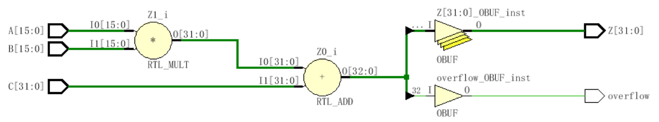
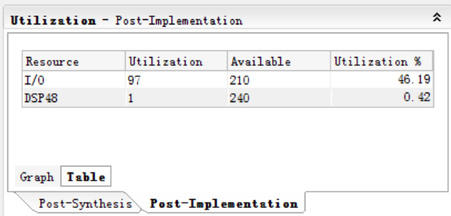
module mac(output [31:0] Z, output overflow,
input [15:0] A, B, input [31:0] C);
assign {overflow, Z} = A*B + C;
endmodule

Slide 30
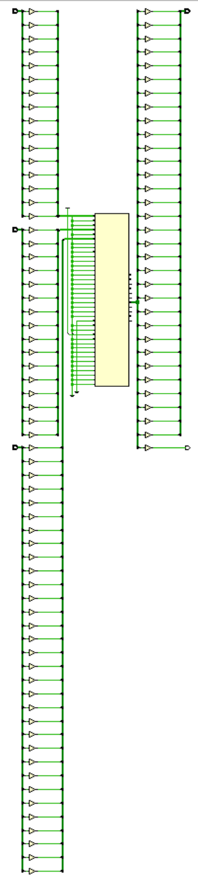

Slide 31
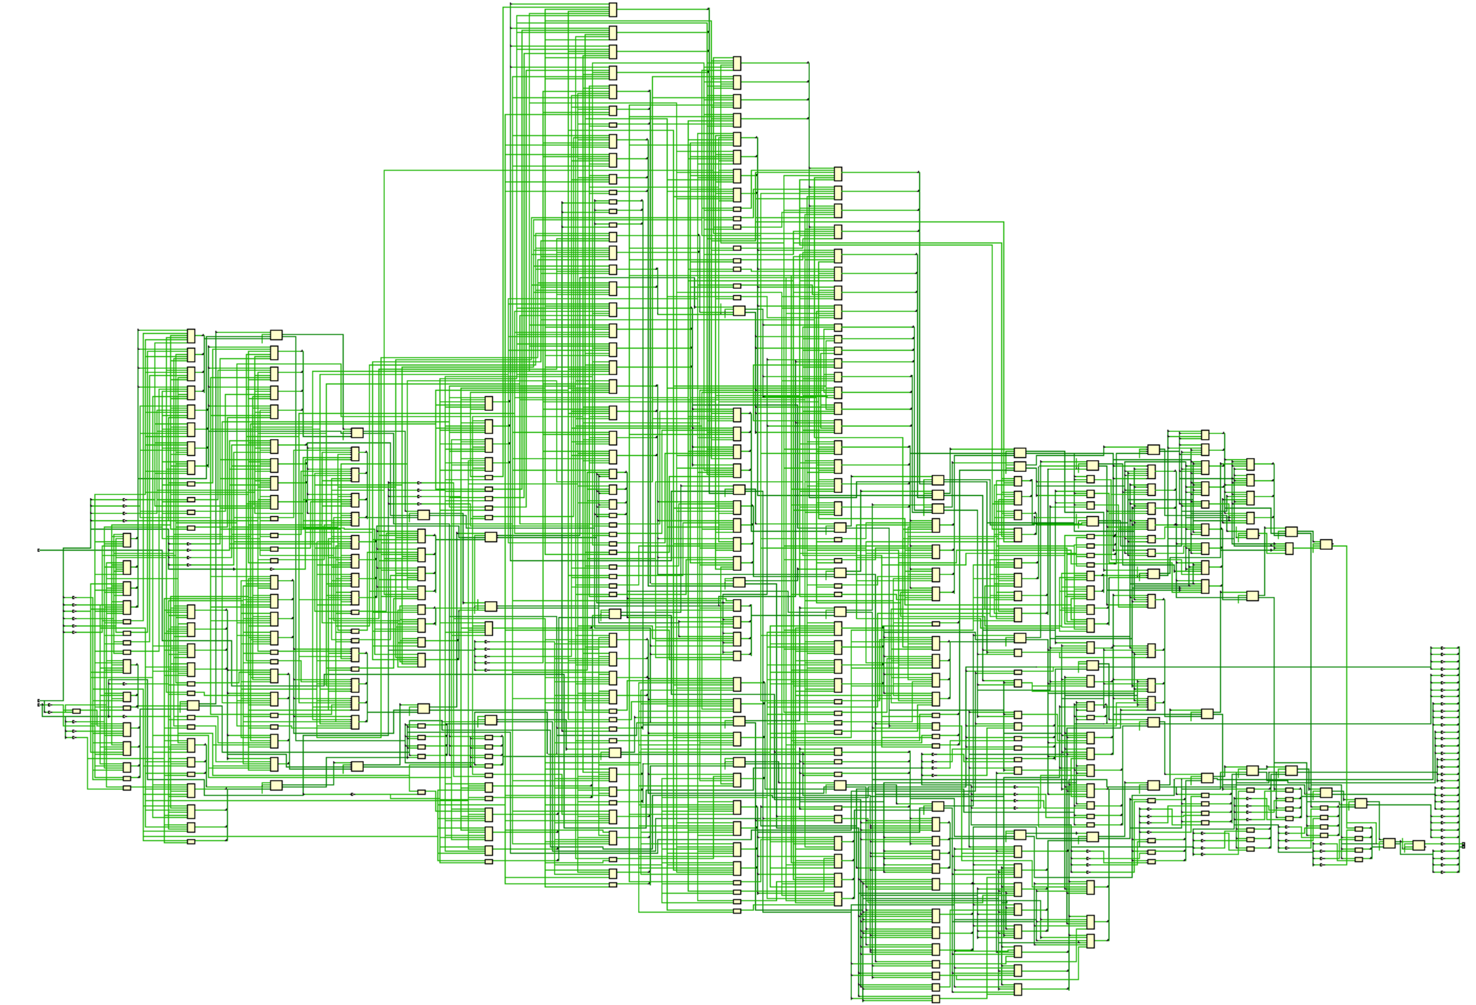

Slide 32
A Few Other Possibilities
The implicit assign
  Goes in the wire declaration
  wire [3:0] sum = a + b;
  Can be a useful shortcut to make code succinct, but doesn’t allow fancy LHS combos
  assign {cout, sum} = a + b + cin;
  Personal choice
    You are welcome to use it when appropriate (I never do!)

Slide 33
Behavioral Verilog
initial and always form basis of all behavioral Verilog
  All other behavioral statements occur within these
  initial and always blocks cannot be nested
  All <LHS> assignments must be to type reg
initial statements start at time 0 and execute once
  If there are multiple initial blocks they all start at time 0 and execute independently. They may finish independently.
If multiple behavioral statements are needed within the initial statement then the initial statement can be made compound with use of begin/end

Slide 34
More on initial statements
Initial statement very useful for testbenches
Initial statements don’t synthesize
Don’t use them in DUT（Device Under Test，被测设备） Verilog (stuff you intend to synthesize)

Slide 35
initial Blocks
`timescale 1 ns / 100 fs
module full_adder_tb;
reg [3:0] stim;
wire s, c;
full_adder(sum, carry, stim[2], stim[1], stim[0]); // instantiate DUT
// monitor statement is special - only needs to be made once,
initial $monitor(“%t: s=%b c=%b stim=%b”, $time, s, c, stim[2:0]);
// tell our simulation when to stop
initial #50 $stop;
initial begin // stimulus generation
for (stim = 4’h0; stim < 4’h8; stim = stim + 1) begin
#5;
end
end
endmodule
all initial blocks start at time 0
multi-statement block enclosed by begin and end

Slide 36
Another initial Statement Example
module stim()
reg m,a,b,x,y;
initial
m = 1’b0;
initial begin
#5 a = 1’b1;
#25 b = 1’b1;
end
initial begin
#10 x = 1’b1;
#25 y = 1’b1;
end
initial
#50 $finish;
endmodule
Time
Event
0
m = 1’b0
5
a = 1’b1
Modelsim
10
x = 1’b1
30
b = 1’b1
35
y = 1’b1
50
$finish
What events at what times will a verilog simulator produce?

Slide 37
always statements
Behavioral block operates CONTINUOUSLY
  Executes at time zero but loops continuously
  Can use a trigger list to control operation; @(a, b, c)
  In absense of a trigger list it will re-evaluate when the last <LHS> assignment completes.
module clock_gen (output reg clock);
initial
clock = 1’b0; // must initialize in initial block
always // no trigger list for this always
#10 clock = ~clock; // always will re-evaluate when
// last <LHS> assignment completes
endmodule

Slide 38
always vs initial
reg [7:0] v1, v2, v3, v4;
initial begin
v1 = 1;
#2 v2 = v1 + 1;
v3 = v2 + 1;
#2 v4 = v3 + 1;
v1 = v4 + 1;
#2 v2 = v1 + 1;
v3 = v2 + 1;
end
reg [7:0] v1, v2, v3, v4;
always begin
v1 = 1;
#2 v2 = v1 + 1;
v3 = v2 + 1;
#2 v4 = v3 + 1;
v1 = v4 + 1;
#2 v2 = v1 + 1;
v3 = v2 + 1;
end
What values does each block produce?
  Lets take our best guess
  Then lets try it in a simulator

Slide 39
Trigger lists (Sensitivity lists)
Conditionally “execute” inside of always block
  Any change on trigger (sensitivity) list, triggers block
    always @(a, b, c) begin
    …
  end
Some mixed simulation tools in use today still do not support Verilog 2001.
Original way to specify trigger list
always @ (X1 or X2 or X3)
In Verilog 2001 can use , instead of or
always @ (X1, X2, X3)
Verilog 2001 also has * for combinational only
always @ (*)
Do you know your design?

Slide 40
Example: Comparator
module compare_4bit_behave(output reg A_lt_B, A_gt_B, A_eq_B,
input [3:0] A, B);
always@( ) begin
end
endmodule
Flush out this template with sensitivity list and implementation
Hint: a if…else if…else statement is best for implementation

Slide 41
if-else 条件语句
case 语句
for循环语句
if (条件表达式) 块语句1
else if (条件表达式2) 块语句2
……
else if (条件表达式n) 块语句n
else 块语句n+1
case (敏感表达式)
值1： 块语句1
值2： 块语句2
……
值n： 块语句n
default：块语句n+1
endcase
for (表达式1；表达式2；表达式3）块语句

Slide 42
if…else if…else statement
General forms…
If (condition)
begin
<statement1>;
<statement2>;
end
else
begin
<statement3>;
<statement4>;
end
If (condition)
begin
<statement1>;
<statement2>;
end
else if (condition2)
begin
<statement3>;
<statement4>;
end
else
begin
<statement5>;
<statement6>;
end
If (condition) begin
<statement1>;
<statement2>;
end
Of course the compound statements formed with begin/end are optional.
Multiple else if’s can be strung along indefinitely

Slide 43
How does and if…else if…else statement synthesize?
  Does not conditionally “execute” block of “code”
  Does not conditionally create hardware!
  It makes a multiplexer or selecting logic
  Generally:
    Hardware for both paths is created
    Both paths “compute” simultaneously
    The result is selected depending on the condition
if (func_add)
alu = a + b;
else if (func_and)
alu = a & b;
else
alu = 8’h00;
+
alu
a[7:0]
1
&
0
8
1
b[7:0]
8’h00
0
8
func_and
func_add

Slide 44
if statement synthesis (continued)
if (a)
func = c & d;
else if (b)
func = c | d;
c
d
1
d
0
q
func
How does this
synthesize?
en
a
b
Latch??
What you ask for is what you get!
func is of type register. When neither a or b are asserted it didn’t not get a new value.
That means it must have remained the value it was before.
That implies memory…i.e. a latch!
Always have an
else to any if to avoid unintended
latches.

Slide 45
More on if statements…
Watch the sensitivity lists…what is missing in this example?
always @(a, b) begin
temp = a – b;
if ((temp < 8’b0) && abs)
out = -temp;
else out = temp;
end
always @ (posedge clk) begin
if (reset) q <= 0;
else if (set) q <= 1;
else q <= data;
end
What is being coded here?
Is it synchrounous or asynch?
Does the reset or the set have
higher priority?

Slide 46
case Statements
Verilog has three types of case statements:
  case, casex, and casez
Performs bitwise match of expression and case item
  Both must have same bitwidth to match!
case
  Can detect x and z! (good for testbenches)
casez
  Uses z and ? as “don’t care” bits in case items and expression
casex
  Uses x, z, and ? as “don’t care” bits in case items and expression
Slide taken direct from Eric Hoffman

Slide 47
Case statement (general form)
case (expression)
alternative1 : statement1; // any of these statements could
alternative2 : statement2; // be a compound statement using
alternative3 : statement3; // begin/end
default : statement4 // always use default for synth stuff
endcase
parameter AND = 2’b00;
parameter OR = 2’b01;
parameter XOR = 2’b10;
case (alu_op)
AND : alu = src1 & src2;
OR : alu = src1 | src2;
XOR : alu = src1 ^ src2;
default : alu = src1 + src2;
endcase
Why always have a default?
Same reason as always having an else with an if statement.
All cases are specified, therefore no unintended latches.
Slide taken direct from Eric Hoffman

Slide 48
Using case To Detect x And z
Only use this functionality in a testbench!
Example taken from Verilog-2001 standard:
case (sig)
1’bz: $display(“Signal is floating.”);
1’bx: $display(“Signal is unknown.”);
default: $display(“Signal is %b.”, sig);
endcase
Slide taken direct from Eric Hoffman

Slide 49
casex Statement
Uses x, z, and ? as single-bit wildcards in case item and expression
Uses first match encountered
always @ (code) begin
casex (code) // case expression
2’b0?: control = 8’b00100110; // case item1
2’b10: control = 8’b11000010; // case item 2 2’b11: control = 8’b00111101; // case item 3
endcase
end
What is the output for code = 2’b01?
What is the output for code = 2’b1x?
Slide taken direct from Eric Hoffman

Slide 50
casez Statement
Uses z, and ? as single-bit wildcards in case item and expression
always @ (code) begin
casez (code)
2’b0?: control = 8’b00100110; // item 1
2’bz1: control = 8’b11000010; // item 2 default: control = 8b’xxxxxxxx; // item 3
endcase
end
What is the output for code = 2b’01?
What is the output for code = 2b’zz?
Slide taken direct from Eric Hoffman

Slide 51
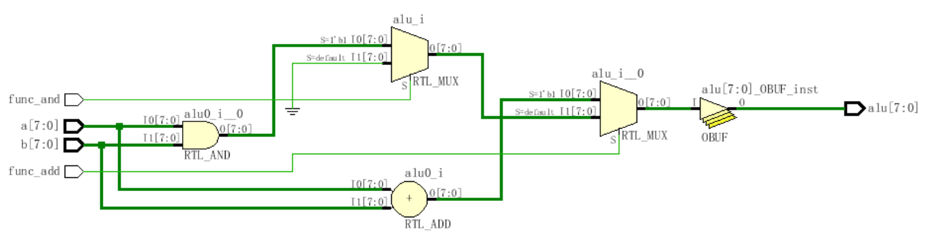
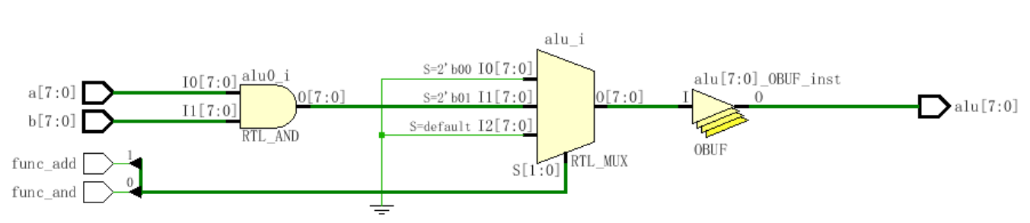
if (func_add)
alu = a + b;
else if (func_and)
alu = a & b;
else
alu = 8’h00;
case({func_add, func_and})
2'b00: alu = 8'h00;
2'b01: alu = a & b;
2'b1x: alu = func_add;
default: alu = 8'h00;
endcase

Slide 52
Loops in Verilog
We already saw the for loop:
reg [15:0] rf[0:15]; // memory structure for modeling register file
reg [5:0] w_addr; // address to write to
for (w_addr=0; w_addr<16; w_addr=w_addr+1)
rf[w_addr[3:0]] = 16’h0000; // initialize register file memory
There are 3 other loops available:
  While loops
  Repeat loop
  Forever loop

Slide 53
while loops
Executes until boolean condition is not true
  If boolean expression false from beginning it will never execute loop
reg [15:0] flag;
reg [4:0] index;
initial begin
index=0;
found=1’b0;
while ((index<16) && (!found)) begin
if (flag[index]) found = 1’b1;
else index = index + 1;
end
if (!found) $display(“non-zero flag bit not found!”);
else $display(“non-zero flag bit found in position %d”,index);
end
Handy for cases where loop termination is a more complex function.
Like a search

Slide 54
repeat Loop
Good for a fixed number of iterations
  Repeat count can be a variable but…
    It is only evaluated when the loops starts
    If it changes during loop execution it won’t change the number of iterations
Used in conjunction with @(posedge clk) it forms a handy & succinct way to wait in testbenches for a fixed number of clocks
initial begin
inc_DAC = 1’b1;
repeat(4095) @(posedge clk); // bring DAC right up to point of rollover
inc_DAC = 1’b0;
inc_smpl = 1’b1;
repeat(7)@(posedge clk); // bring sample count up to 7
inc_smpl = 1’b0;
end

Slide 55
forever loops
We got a glimpse of this already with clock generation in testbenches.
Only a $stop, $finish or a specific disable can end a forever loop.
initial begin
clk = 0;
forever #10 clk = ~ clk;
end
Clock generator is by far the most
common use of a forever loop

Slide 56
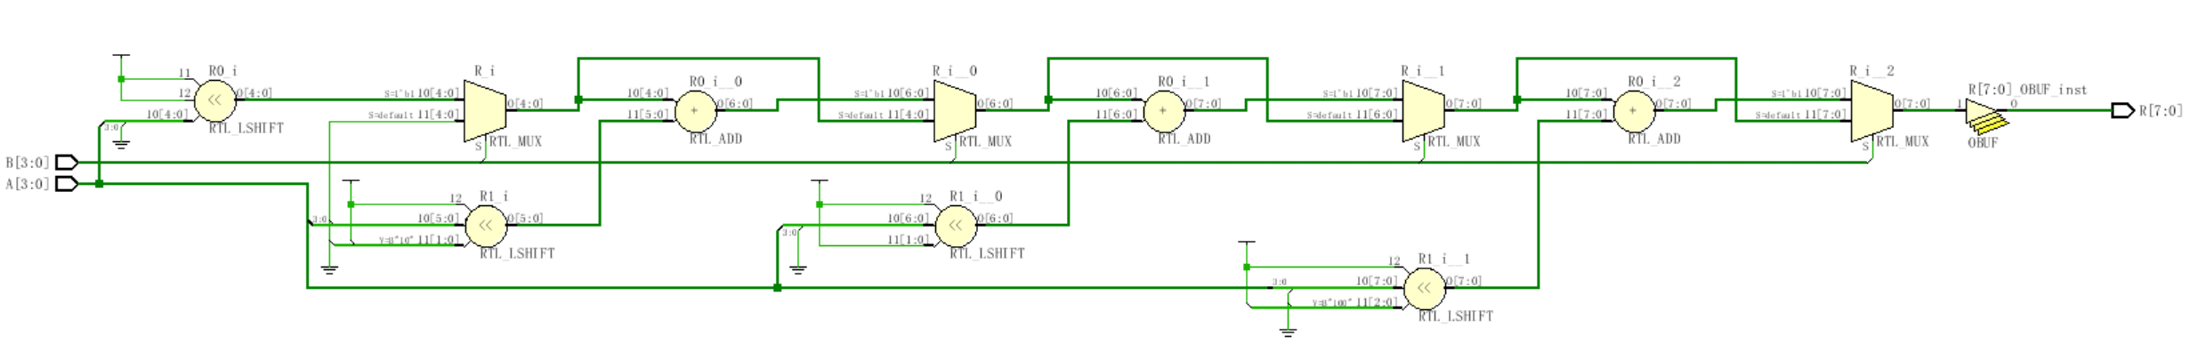
module mult4b(output reg [7:0] R, input [3:0] A, input [3:0] B);
integer i;
always @(A, B) begin
R = 0;
for(i=1; i<=4; i=i+1)
if(B[i-1]) R = R + (A<<i);
end
endmodule

Slide 57
基本形式：<寄存器变量>＝<表达式>；
外部模式：<定时控制> <寄存器变量>＝<表达式>；
内部模式：<寄存器变量>＝ <定时控制> <表达式>；
定时控制分为两类：延时控制
事件控制 @(事件控制敏感表）
赋值语句
阻塞型过程赋值
  赋值算符“＝” ：前一条语句没有完成赋值过程之前，后面的语句不可能被执行。
非阻塞型过程赋值
  赋值算符“<＝” ：一条非阻塞型赋值语句的执行，并不会影响块中其它语句的执行。
连续赋值语句
  只要输入端操作数的值发生变化，该语句就重新计算并刷新赋值结果。用关键词assign来区分。

Slide 58
Blocking vs non-Blocking
Blocking “Evaluated” sequentially
Works a lot like software (danger!)
Used for combinational logic
module addtree(output reg [9:0] out,
input [7:0] in1, in2, in3, in4);
reg [8:0] part1, part2;
always @(in1, in2, in3, in4) begin
part1 = in1 + in2;
part2 = in3 + in4;
out = part1 + part2;
end
endmodule
in1
in2
in3
in4
+
+
part1
part2
+
out
Slide taken direct from Eric Hoffman

Slide 59
Non-Blocking Assignments
“Updated” simultaneously if no delays given
Used for sequential logic
module swap(output reg out0, out1, input rst, clk);
always @(posedge clk) begin
if (rst) begin
out0 <= 1’b0;
out1 <= 1’b1;
end
else begin
out0 <= out1;
out1 <= out0;
end
end
endmodule
D Q
rst to 0
out0
rst
clk
D Q
rst to 1
out1
Slide taken direct from Eric Hoffman

Slide 60
Swapping if done in Blocking
In blocking, need a “temp” variable
module swap(output reg out0, out1, input in0, in1, swap);
reg temp;
always @(*) begin
out0 = in0;
out1 = in1;
if (swap) begin
temp = out0;
out0 = out1;
out1 = temp;
end
end
endmodule
Which values get included on the sensitivity list from *?
in0
in1
out0
swap
out1
Slide taken direct from Eric Hoffman

Slide 61
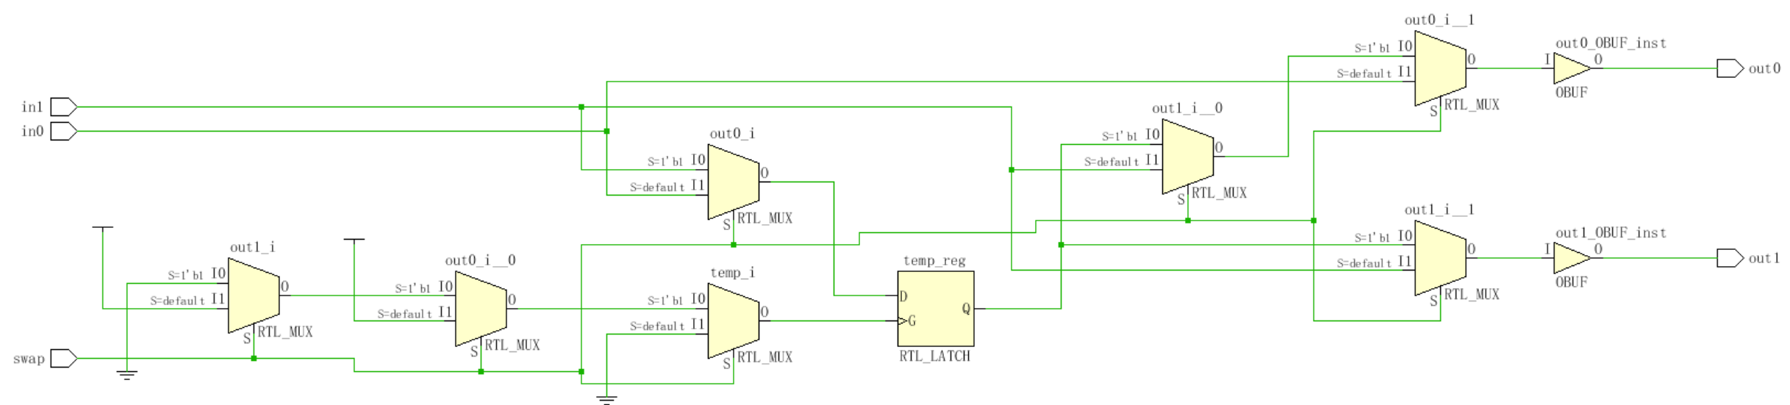
Swapping if done in Non-Blocking
module swap(output reg out0, out1, input in0, in1, swap);
reg temp;
always @(*) begin
out0 <= in0;
out1 <= in1;
if (swap) begin
temp <= out0;
out0 <= out1;
out1 <= temp;
end
end
endmodule

Slide 62
More on Blocking
Called blocking because….
  The evaluation of subsequent statements <RHS> are blocked, until the <LHS> assignment of the current statement is completed.
q1
q2
q3
module pipe(clk, d, q);
input clk,d;
output q;
reg q;
always @(posedge clk) begin
q1 = d;
q2 = q1;
q3 = q2;
end
endmodule
d
clk
Lets code this
Simulate this in your head…
Remember blocking behavior of: <LHS> assigned before
<RHS> of next evaluated.
Does this work as intended?
Slide taken direct from Eric Hoffman

Slide 63
More on Non-Blocking
Lets try that again
q1
q2
q3
d
module pipe(clk, d, q);
input clk,d;
output q;
reg q;
always @(posedge clk) begin
q1 <= d;
q2 <= q1;
q3 <= q2;
End
endmodule;
clk
Lets code this
With non-blocking statements the <RHS> of subsequent statements are not blocked. They are all evaluated simultaneously.
The assignment to the <LHS> is then scheduled to occur.
This will work as intended.
Slide taken direct from Eric Hoffman

Slide 64
So Blocking is no good and we should always use Non-Blocking??
Consider combinational logic
module ao4(z,a,b,c,d);
input a,b,c,d;
output z;
reg z,tmp1,tmp2;
always @(a,b,c,d) begin
tmp1 <= a & b;
tmp2 <= c & d;
z <= tmp1 | tmp2;
end
endmodule
The inputs (a,b,c,d) in the sensitivity list change, and the always block is evaluated.
New assignments are scheduled for tmp1 & tmp2 variables.
A new assignment is scheduled for z using the previous tmp1 & tmp2 values.
Does this work?
Slide taken direct from Eric Hoffman

Slide 65
Why not non-Blocking for Combinational
Can we make this example work?
module ao4(z,a,b,c,d);
input a,b,c,d;
output z;
reg z,tmp1,tmp2;
always @(a,b,c,d) begin
tmp1 <= a & b;
tmp2 <= c & d;
z <= tmp1 | tmp2;
end
endmodule
module ao4(z,a,b,c,d);
input a,b,c,d;
output z;
reg z,tmp1,tmp2;
always @(a,b,c,d,tmp1,tmp2) begin
tmp1 <= a & b;
tmp2 <= c & d;
z <= tmp1 | tmp2;
end
endmodule
Yes
Put tmp1 & tmp2 in the trigger list
What is the downside of this?
Slide taken direct from Eric Hoffman

Slide 66
任务（task）
函数（function）
任务和函数结构之间的差异：
  一个任务块可以含有时间控制结构，而函数块则没有；
  一个任务块可以有输入和输出，而函数块必须有至少一个输入，没有任何输出；
  任务块的引发是通过一条语句，而函数块只有当它被引用在一个表达式中时才会生效。
task 任务名；
端口与类型说明；
局部变量说明；
块语句
endtask
function <位宽说明> 函数名；
输入端口与类型说明；
局部变量说明；
块语句
endfunction

Slide 67
functions
Declared and referenced within a module
Used to implement combinational behavior
  Contain no timing controls or tasks
Inputs/outputs
  Must have at least one input argument
  Has only one output (no inouts)
  Function name is implicitly declared return variable
  Type and range of return value can be specified (1-bit wire is default)
Slide taken direct from Eric Hoffman

Slide 68
When to use functions?
Usage rules:
  May be referenced in any expression (RHS)
  May call other functions
Requirements of procedure (implemented as function)
  No timing or event control
  Returns a single value
  Has at least 1 input
  Uses only behavioral statements
  Only uses blocking assignments (combinational)
Mainly useful for conversions, calculations, and selfchecking routines that return boolean. (testbenches)
Slide taken direct from Eric Hoffman

Slide 69
Function Example
module word_aligner (word_out, word_in);
output [7: 0] word_out;
input [7: 0] word_in;
assign word_out = aligned_word(word_in); // invoke function
function [7: 0] aligned_word; // function declaration
input [7: 0] word;
begin
aligned_word = word;
if (aligned_word != 0)
while (aligned_word[7] == 0) aligned_word = aligned_word << 1;
end
endfunction
endmodule
size of return value
input to function
Does this synthsize?
Slide taken direct from Eric Hoffman

Slide 70
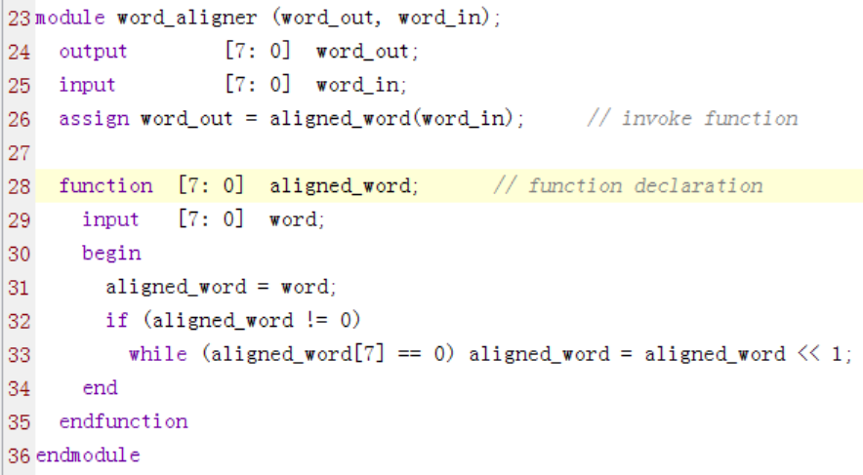
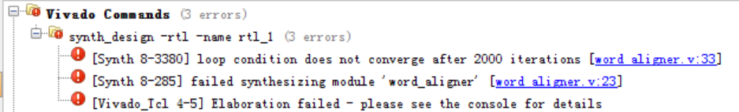
Function Example

Slide 71
Function Example [2]
module arithmetic_unit (result_1, result_2, operand_1, operand_2,);
output [4: 0] result_1;
output [3: 0] result_2;
input [3: 0] operand_1, operand_2;
assign result_1 = sum_of_operands (operand_1, operand_2);
assign result_2 = larger_operand (operand_1, operand_2);
function [4: 0] sum_of_operands(input [3:0] operand_1, operand_2);
sum_of_operands = operand_1 + operand_2;
endfunction
function [3: 0] larger_operand(input [3:0] operand_1, operand_2);
larger_operand = (operand_1 >= operand_2) ? operand_1 : operand_2;
endfunction
endmodule
function call
function inputs
function output
Slide taken direct from Eric Hoffman

Slide 72
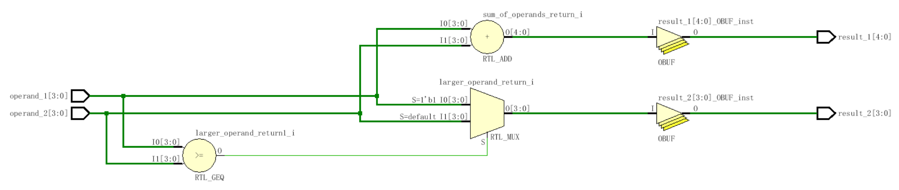
Function Example [2]

Slide 73
Re-Entrant (recursive) functions
Use keyword automatic to enable stack saving of function working space and enable recursive functions.
module top;
//Define the factorial function
function automatic integer factorial;
input [31:0] oper;
begin
if (oper>=2)
factorial = factorial(oper-1)*oper;
else
factorial = 1;
end
endfunction
initial begin
result = factorial(4);
$display(“Result is %d”,result);
end
endmodule
Is this how you would do it?
KISS
Slide taken direct from Eric Hoffman

Slide 74
tasks (much more useful than functions)
Functions: | Tasks:
A function can enable another function, but not another task | A task can enable other tasks and functions
Functions must execute in zero delay | Tasks may execute in non-zero simulation time
Functions can have no timing or even control statements | Tasks may contain delay, event or timing control. (i.e. ➔ @, #)
Function must have at least one input argument. | Task may have zero or more arguments of type input, output, or inout
Fucntions always return a single value. The cannot have output or inout arguments | Task do not return a value, but rather pass multiple values through output and input arguments
Tasks can modify global signals too, perhaps naughty, but I do it all the time.
Slide taken direct from Eric Hoffman

Slide 75
Why use Tasks?
Tasks provide the ability to
  Execute common procedures from multiple places
  Divide large procedures into smaller ones
Local variables can be declared & used
Personally, I only use tasks in testbenches, but they are very handy there.
  Break common testing routines into tasks
    Initialization tasks
    Stimulus generation tasks
    Self Checking tasks
  Top level test then becomes mainly calls to tasks.
Slide taken direct from Eric Hoffman

Slide 76
Task Example [Part 1]
module adder_task (c_out, sum, clk, reset, c_in, data_a, data_b);
output reg [3: 0] sum;
output reg c_out;
input [3: 0] data_a, data_b;
input clk, reset, c_in;
always @(posedge clk or posedge reset) begin
if (reset) {c_out, sum} <= 0;
else add_values (sum, c_out, data_a, data_b, c_in); // invoke task
end
// Continued on next slide
Calling of task
Slide taken direct from Eric Hoffman

Slide 77
Task Example [Part 2]
// Continued from previous slide
task add_values; // task declaration
output reg [3: 0] SUM;
output reg C_OUT;
input [3: 0] DATA_A, DATA_B;
input C_IN;
{C_OUT, SUM} = DATA_A + (DATA_B + C_IN);
endtask
endmodule
Could have instead specified inputs/outputs using a port list.
task add_values (output reg [3: 0] SUM, output reg C_OUT,
input [3:0] DATA_A, DATA_B, input C_IN);
task outputs
task inputs
Slide taken direct from Eric Hoffman

Slide 78
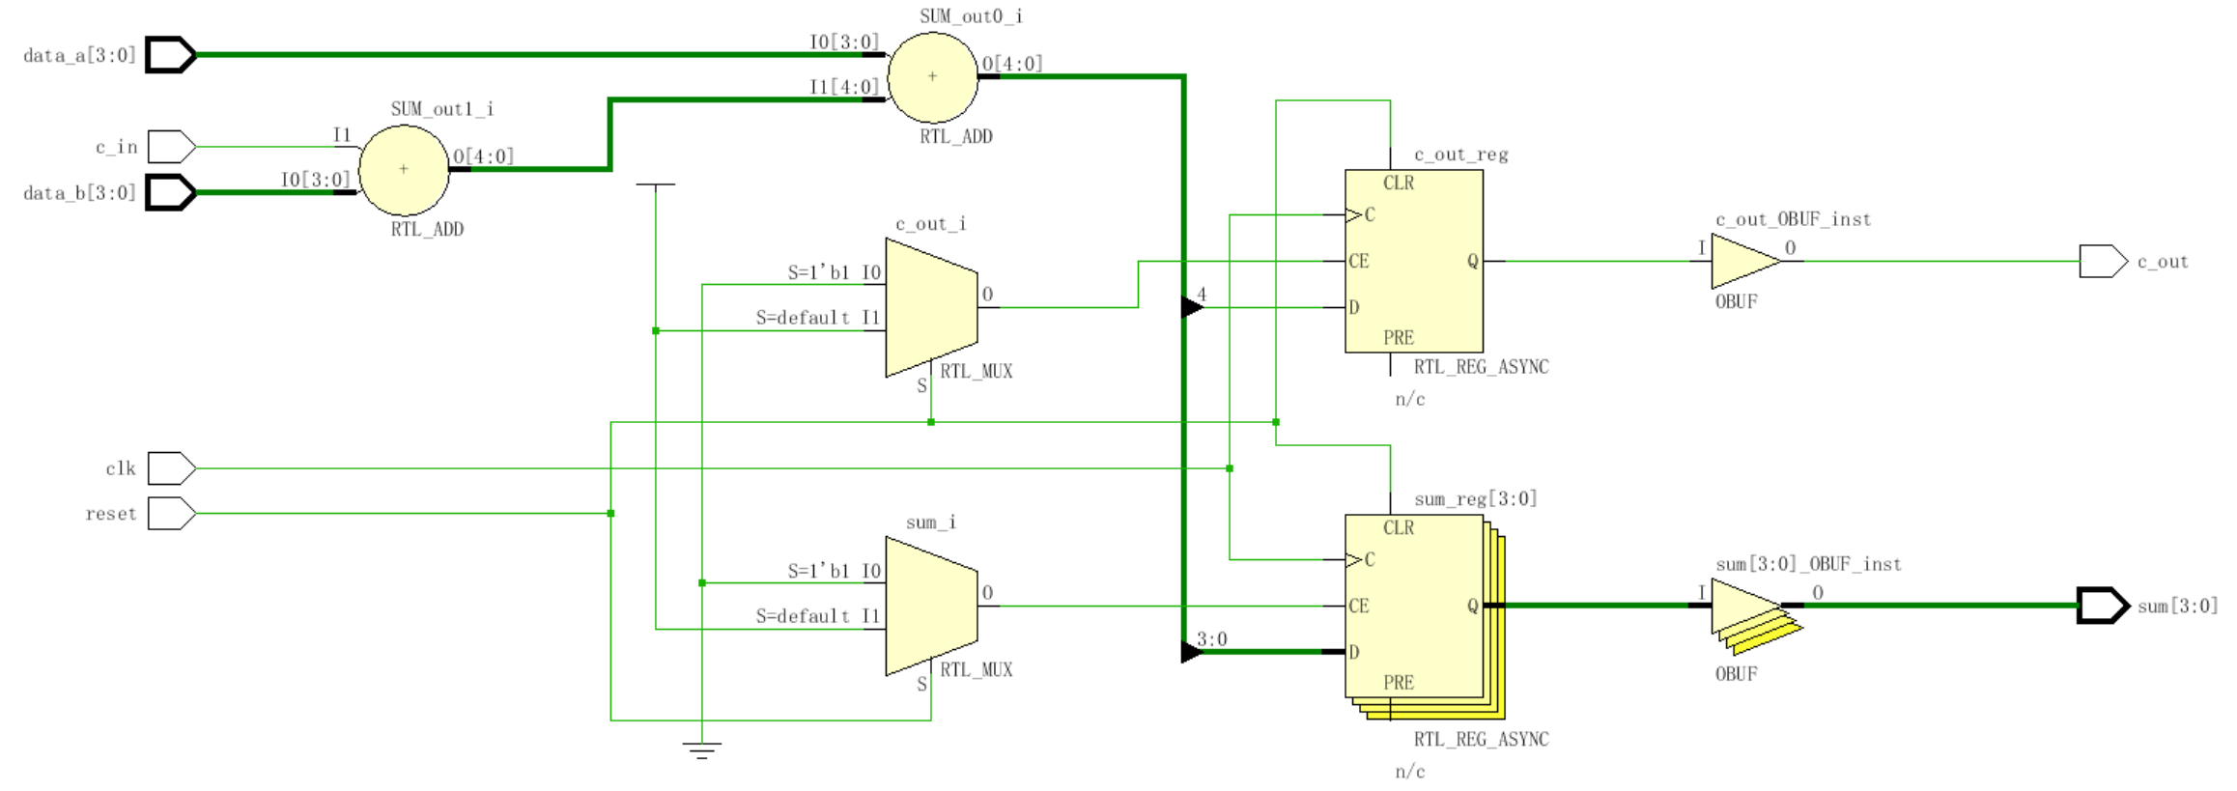
Task Example [Part 3]

Slide 79
Task Example [2]
task leading_1(output reg [2:0] position, input [7:0] data_word);
reg [7:0] temp;
  begin
  temp = data_word;
  position = 7;
  while (!temp[7]) begin
  temp = temp << 1;
  position = position - 1;
  end
  end
endtask
internal task variable
NOTE:
“while” loops usually
not synthesizable!
What does this task assume for it to work correctly?
How do tasks differ from modules?
How do tasks differ from functions?
Slide taken direct from Eric Hoffman

Slide 80
时序控制
  由“#”符号引入的延迟控制。它将程序的执行过程中断一定的时间，时间的长度由<time>的值来确定。
  由“@”符号引入的事件控制。一个事件可以通过运行表达式“-> event”变量被激发。
  等待语句。直到表达式计算为真之前，都延时下一个语句的执行。
  延迟定义块。对模块中某一指定
  的路径进行延迟定义，这一路径
  连接模块的输入端口与输出端口
  （或双向端口）。
＃ <time> <statement> ；
@ (<posedge>|<negedge>|<signals> ) <statement>；
wait (<expression>) <statement> ；
specify
(<expression>) = <time>
……
endspecify

Slide 81
Named Blocks
Blocks (begin/end) or (fork/join) can be named
  Local variables can be declared for the named block
  Variables in a named block can be accessed using hierarchical naming reference
  Named blocks can be disabled (i.e. execution stopped)
module top();
initial begin: block1
integer i; // i is local to block1
// top.block1.i
…
end // end of block1
endmodule
block name

Slide 82
disable Statement
Similar to the “break” statement in C
  Disables execution of the current block (not permanently)
begin : break
for (i = 0; i < n; i = i+1) begin : continue
@(posedge clk)
if (a == 0) // "continue" loop
disable continue;
if (a == b) // "break" from loop
disable break;
statement1
statement2
end
end
What occurs if (a==0)?
What occurs if (a==b)?
How do they differ?

Slide 83
File I/O – Why?
If we don’t want to hard-code all information in the testbench, we can use input files
Help automate testing
  One file with inputs
  One file with expected outputs
Can have a software program generate data
  Create the inputs for testing
  Create “correct” output values for testing
  Can use files to “connect” hardware/software system

Slide 84
Opening/Closing Files
$fopen opens a file and returns an integer descriptor
  integer fd = $fopen(“filename”);
  integer fd = $fopen(“filename”, r);
  If file cannot be open, returns a 0
  Can output to more than one file simultaneously by writing to the OR ( | ) of the relevant file descriptors
    Easier to have “summary” and “detailed” results
$fclose closes the file
$fclose(fd);

Slide 85
Writing To Files
Output statements have file equivalents
  $fmonitor()
  $fdisplay()
  $fstrobe()
  $fwrite() // write is like a display without the \n
These system calls take the file descriptor as the first argument
  $fdisplay(fd, “out=%b in=%b”, out, in);

Slide 86
Reading From Files
Read a binary file: $fread(destination, fd);
  Can specify start address & number of locations too
  Good luck! I have never used this.
Very rich file manipulation (see IEEE Standard)
  $fseek(), $fflush(), $ftell(), $rewind(), …
Will cover a few of the more common read commands next

Slide 87
Using $fgetc to read characters
module file_read()
parameter EOF = -1;
integer file_handle,error,indx;
reg signed [15:0] wide_char;
reg [7:0] mem[0:255];
reg [639:0] err_str;
initial begin
indx=0;
file_handle = $fopen(“text.txt”,”r”);
error = $ferror(file_handle,err_str);
if (error==0) begin
wide_char = 16’h0000;
while (wide_char!=EOF) begin
wide_char = $fgetc(file_handle);
mem[indx] = wide_char[7:0];
$write(“%c”,mem[indx]);
indx = indx + 1;
end
end
else $display(“Can’t open file…”);
$fclose(file_handle);
end
endmodule
The quick brown fox jumped over the lazy dogs
text.txt
When finished the array mem will contain the characters of this file one by one, and the file will have been echoed to the screen.
Why wide_char[15:0] and why signed?

Slide 88
Using $fgets to read lines
module file_read2()
integer file_handle,error,indx,num_bytes_in_line;
reg [256*8:1] mem[0:255],line_buffer;
reg [639:0] err_str;
initial begin
indx=0;
file_handle = $fopen(“text2.txt”,”r”);
error = $ferror(file_handle,err_str);
if (error==0) begin
num_bytes_in_line = $fgets(line_buffer,file_handle);
while (num_bytes_in_line>0) begin
mem[indx] = line_buffer;
$write(“%s”,mem[indx]);
indx = indx + 1;
num_bytes_in_line = $fgets(line_buffer,file_handle);
end
end
else $display(“Could not open file text2.txt”);
$fgets() returns the number of bytes in the line. When this is a
zero you know you hit EOF.

Slide 89
Using $fscanf to read files
module file_read3()
integer file_handle,error,indx,num_matches;
reg [15:0] mem[0:255][1:0];
reg [639:0] err_str;
initial begin
indx=0;
file_handle = $fopen(“text3.txt”,”r”);
error = $ferror(file_handle,err_str);
if (error==0) begin
num_matches = $fscanf(file_handle,”%h %h”,mem[indx][0],mem[indx][1]);
while (num_matches>0) begin
$display(“data is: %h %h”,mem[indx][0],mem[indx[1]);
indx = indx + 1;
num_matches = $fscanf(file_handle,”%h %h”,mem[indx][0],mem[indx][1]);
end
end
else $display(“Could not open file text3.txt”);
12f3 13f3
abcd 1234
3214 21ab
text3.txt

Slide 90
Loading Memory Data From Files
This is very useful (memory modeling & testbenches)
  $readmemb(“<file_name>”,<memory>);
  $readmemb(“<file_name>”,<memory>,<start_addr>,<finish_addr>);
  $readmemh(“<file_name>”,<memory>);
  $readmemh(“<file_name>”,<memory>,<start_addr>,<finish_addr>);
$readmemh ➔ Hex data…$readmemb ➔ binary data
  But they are reading ASCII files either way (just how numbers are represented)
// addr data
@0000 10100010
@0001 10111001
@0002 00100011
// addr data
@0000 A2
@0001 B9
@0002 23
//data
A2
B9
23
example “binary”
file
example “hex”
file
address is optional for the lazy

Slide 91
Example of $readmemh
module rom(input clk; input [7:0] addr; output [15:0] dout);
reg [15:0] mem[0:255]; // 16-bit wide 256 entry ROM
reg [15:0] dout;
initial
$readmemh(“constants”,mem);
always @(negedge clk) begin
///////////////////////////////////////////////////////////
// ROM presents data on clock low //
/////////////////////////////////////////////////////////
dout <= mem[addr];
end
endmodule

Slide 92
‘Include Compiler Directives
`include filename
  Inserts entire contents of another file at compilation
  Can be placed anywhere in Verilog source
  Can provide either relative or absolute path names
Example 1:
    module use_adder8(…);
    `include “adder8.v” // include the task for adder8
Example 2:
    module cppc_dig_tb();
    `include “/home/ehoffman/ece551/project/tb_tasks.v”
Useful for including tasks and functions in multiple modules

